Slide 1
SDN and Beyond
Ghufran Baig
Mubashir Adnan Qureshi

Slide 2
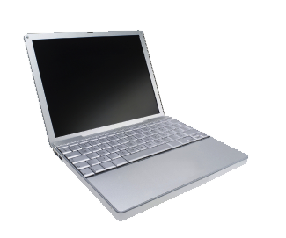
Data
Data

Slide 3
Packets may be corrupted
?!%%*
Data
Data

Slide 4
Packets may arrive out of order
1
2

Slide 5
Packets may be duplicated
Duplicate
Data
Data

Slide 6
They may not arrive at all
Data
Data
Full

Slide 7
Why was an Internet so simple and dumb so successful?
Notes:
7

Slide 8
The Internet was successful because it was simple and dumb
Notes:
8

Slide 9
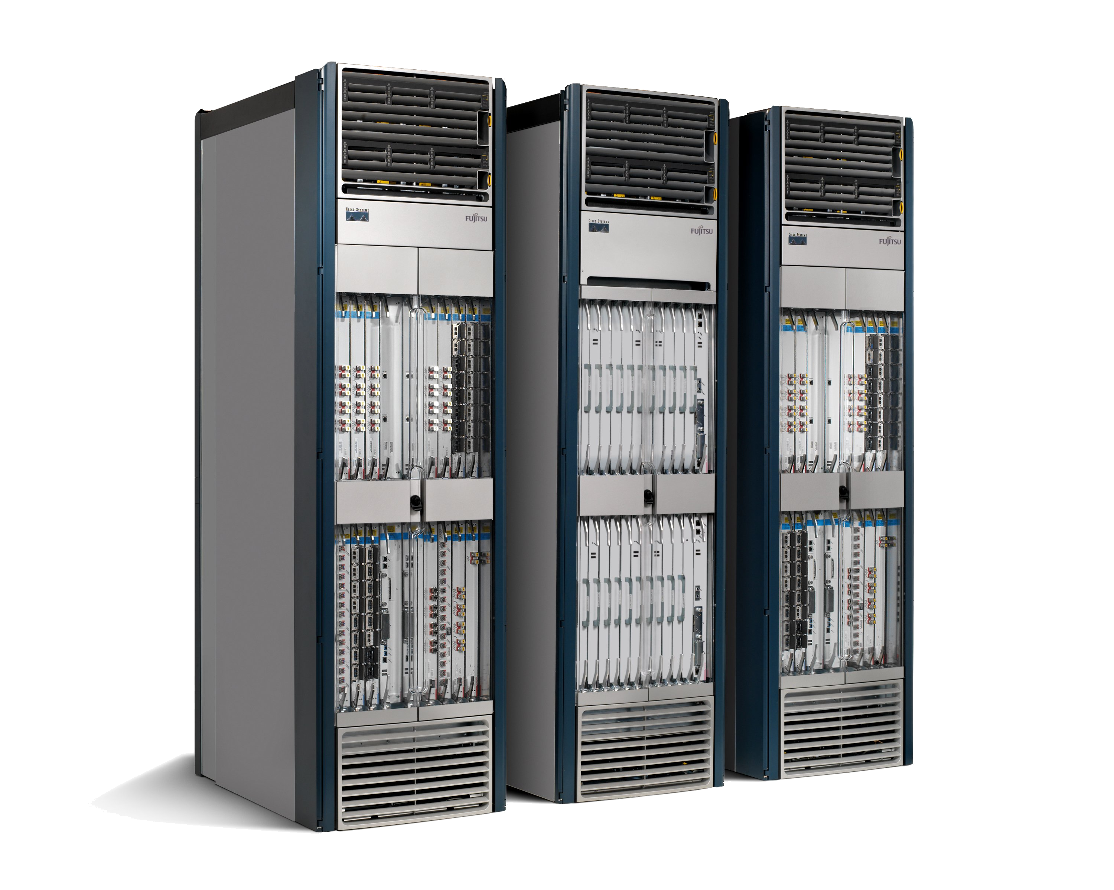
50+ million lines of code
Tens of billions of transistors
Software
Hardware
Routers are fragile and insecure
Bloated and power hungry
Notes:
9

Slide 10
Current State
Computers became easier to use and more reliable…
Networks became harder to manage and less reliable…

Slide 11
Traditional Computer Networks
Data plane:
Packet streaming
Forward, filter, buffer, mark,
rate-limit, and measure packets
Notes:
Maybe this is a better picture… though need some details of what happens in each plane… like in next slides… or, have both?

Slide 12
Traditional Computer Networks
Control plane:
Distributed algorithms
Track topology changes, compute routes, install forwarding rules
Notes:
Maybe this is a better picture… though need some details of what happens in each plane… like in next slides… or, have both?

Slide 13
Traditional Computer Networks
Management plane:
Human time scale
Collect measurements and configure the equipment
Notes:
Maybe this is a better picture… though need some details of what happens in each plane… like in next slides… or, have both?

Slide 14
Software Defined Networking (SDN)
Logically-centralized control
API to the data plane
Dumb,
fast
Switches

Slide 15
OpenFlow
Control Path (Software)
Data Path (Hardware)
OpenFlow/SDN tutorial, Srini Seetharaman, Deutsche Telekom, Silicon Valley Innovation Center

Slide 16
OpenFlow
OpenFlow Controller
OpenFlow Protocol (SSL/TCP)
Control Path
OpenFlow
Data Path (Hardware)
OpenFlow/SDN tutorial, Srini Seetharaman, Deutsche Telekom, Silicon Valley Innovation Center
Notes:
Leverages hardware inside most switches today (ACL tables)

Slide 17


OpenFlow Switching
Controller
OpenFlow Client
PC
Software
Layer
OpenFlow Table
MAC
src
MAC
dst
IP
Src
IP
Dst
TCP
sport
TCP
dport
Action
Hardware
Layer
*
*
*
5.6.7.8
*
*
port 1
port 1
port 2
port 3
port 4
5.6.7.8
1.2.3.4
17
The Stanford Clean Slate Program, http://cleanslate.stanford.edu

Slide 18
OpenFlow Table Entry
Rule
Action
Stats
Packet + byte counters
Forward packet to port(s)
Encapsulate and forward to controller
Drop packet
Send to normal processing pipeline
…
Switch
Port
MAC
src
MAC
dst
Eth
type
VLAN
ID
IP
Src
IP
Dst
IP
Prot
TCP
sport
TCP
dport
+ mask
The Stanford Clean Slate Program, http://cleanslate.stanford.edu
Notes:
The earliest prototype… just to get an idea

Slide 19
OpenFlow Examples
Switching
Switch
Port
MAC
src
MAC
dst
Eth
type
VLAN
ID
IP
Src
IP
Dst
IP
Prot
TCP
sport
TCP
dport
Action
*
*
00:1f:..
*
*
*
*
*
*
*
port6
Routing
Switch
Port
MAC
src
MAC
dst
Eth
type
VLAN
ID
IP
Src
IP
Dst
IP
Prot
TCP
sport
TCP
dport
Action
*
*
*
*
*
*
5.6.7.8
*
*
*
port6
Firewall
Switch
Port
MAC
src
MAC
dst
Eth
type
VLAN
ID
IP
Src
IP
Dst
IP
Prot
TCP
sport
TCP
dport
Action
*
*
*
*
*
*
*
*
*
22
drop
OpenFlow/SDN tutorial, Srini Seetharaman, Deutsche Telekom, Silicon Valley Innovation Center

Slide 20
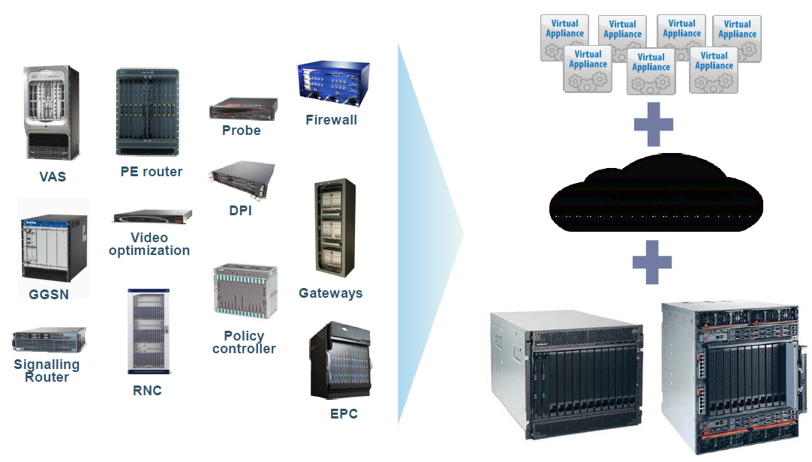
Network Function Virtualization

Slide 21
NFV Benefits
Decoupling the network function from the support infrastructure.
This can provide independent scaling and innovation among both.
Reuse of a single platform for different applications
Allows network operators to share resources across services and across different customer bases.
Elastically share resources from a common pool among various network functions
Virtual networks can be created and managed by end users and third parties
Previously reserved only for native network operators

Slide 22
AT&T Domain 2.0
Network services and infrastructure to be used, provisioned, and orchestrated like cloud services in data centers.
Manage, manipulate, and consume services on demand and in near real time.
From , vendor specific hardware with pre-integrated
feature functions
specific applicable scale of use
To, Network Function Virtualization Infrastructure (NFVI)
capable of being directed with software and SDN protocols to perform network functions and services.
Services can be instantiated consuming incremental resources from a common pool
Notes:
The most typical type of substrate being servers that support NFV, followed by packet forwarding capabilities based on merchant silicon

Slide 23
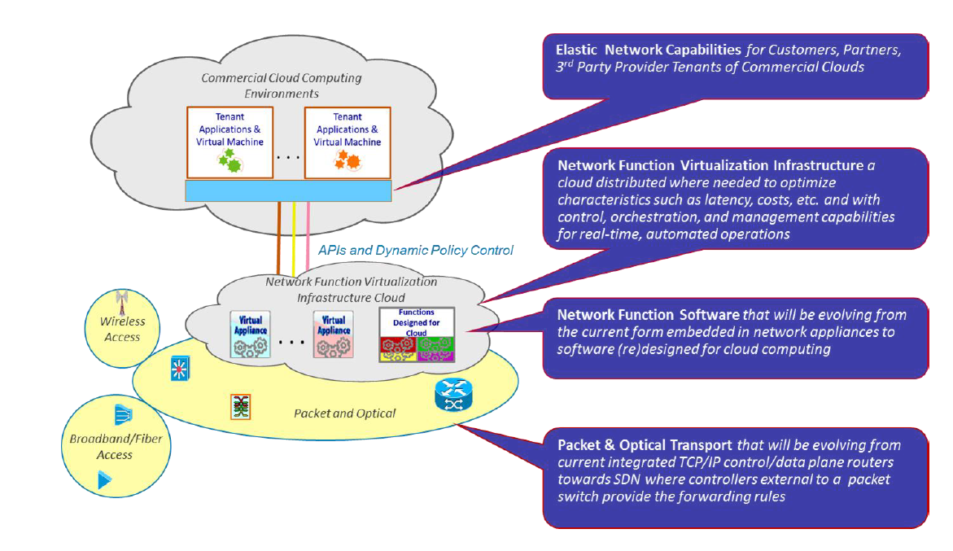

Slide 24
D 2.0 Benefits
Network Services instantiated from the common resource pool (Cloud)
Planning and Growing infrastructure easier to manage
Better utilization of physical resources,
Reduced CAPEX for ISP
faster time to market for new products and services
Notes:
routers, switches, edge caches, and middle-boxes

Slide 25
eCOMP
Enhanced Control, Orchestration, Management and Policy
Software Platform to realize D 2.0 initiative
Design time framework to design, define and program the platform
Runtime execution framework to execute the logic programmed in the design time framework

Slide 26
eCOMP Components
Orchestration of virtual machines (VMs) - for compute, networking, storage, and measurement
Controllers – to implement the network plan and configure and monitor applications
Data Collection and Analytics – to monitor KPIs and inform decisions on policy
Policy – to help automate certain decisions
Active and Available Inventory - data for the cloud infrastructure and the VNFs is collected in a geo-redundant data base.
Service Design and Creation – a design studio to facilitate service and infrastructure design, allowing re-use across the enterprise

Slide 27
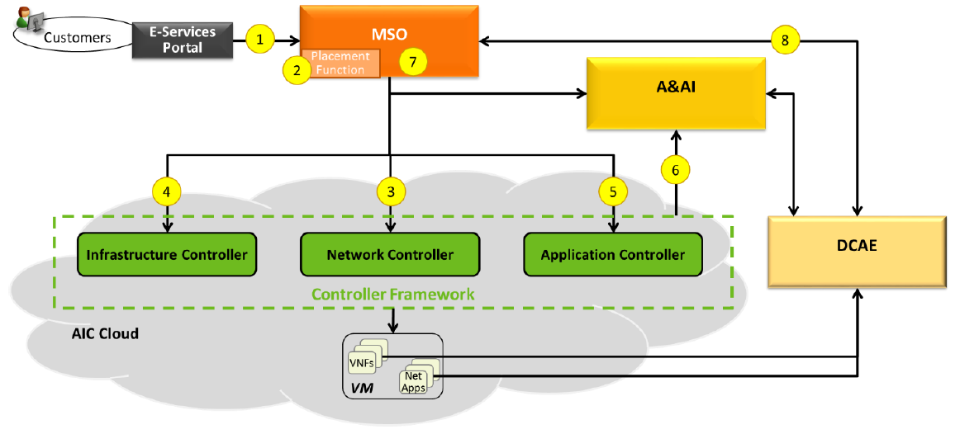
eCOMP Workflow
Notes:
MSO: Master service orchestrator
A&AI: Active and available inventory
DCAE: Data Collection and Analytics engine

Slide 28
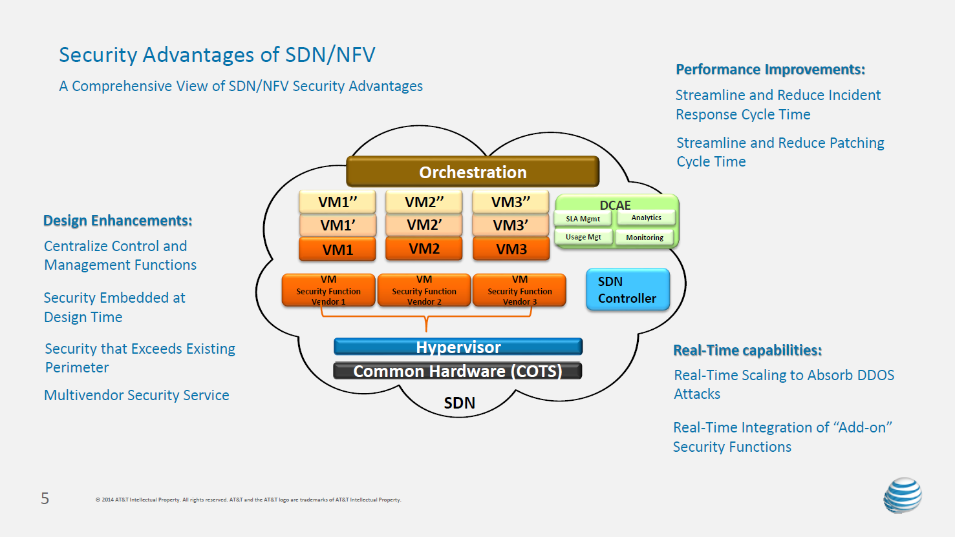

Slide 29
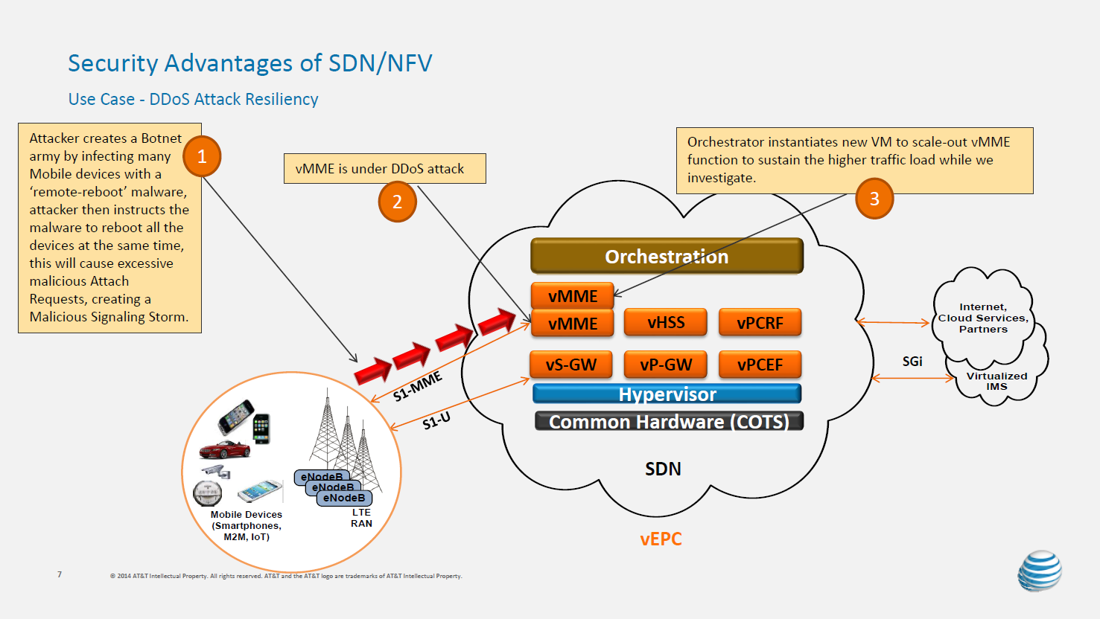
Notes:
MME : Mobility management entity

Slide 30
